Slide 1

Gossip Protocol in CDNs
Kiyor Cai
ChinaCache Architect

Slide 2

My Background
Architect at ChinaCache
4+ years in CDN company
ChinaCache is one of the largest CDN providers in China

Slide 3
What is CDN?

Slide 4
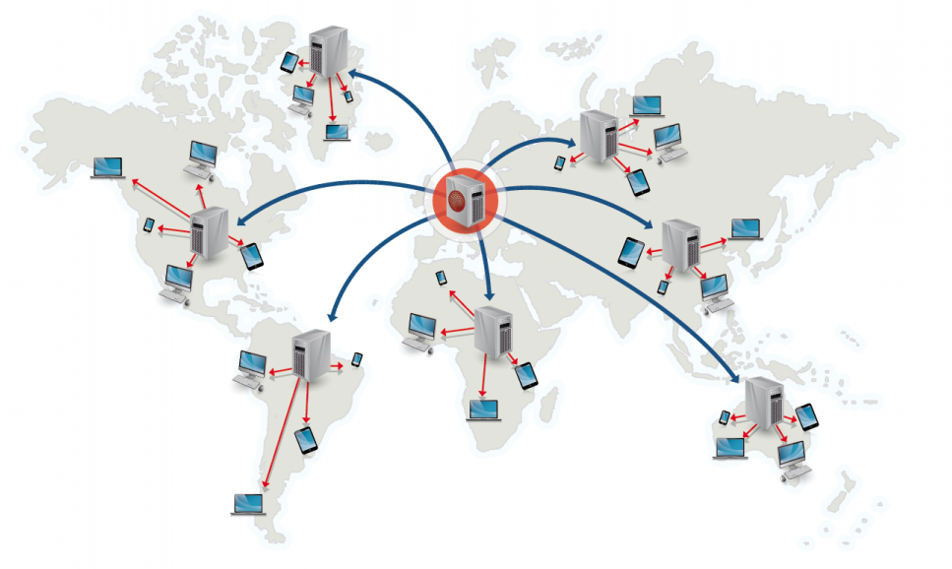
A content delivery network (CDN) is a system of distributed servers (network) that deliver webpages and other Web content to a user based on the geographic locations of the user, the origin of the webpage and a content delivery server. ... CDNs also provide protection from large surges in traffic.
Image via hostucan.com

Slide 5
What are some of the challenges I face everyday?

Slide 6

Large Network, with Chinese characteristics
Over 800 million internet users in China!
Image via Washington Post

Slide 7

ISPs’ in China have…
Few interconnections with other ISPs
High congestion at peering points
Poor routing/fragmentation
Not to mention limited international communication
Three international exit points TOTAL
And of course….
The Great Firewall of China**
**all traffic crossing the borders will be filtered
Screenshot via blog.xuite.net

Slide 8
How to keep servers happy?
Two traditional methods:
Push
Centralized Server pushes tasks/configurations to API on clients concurrently
Slow since network.
If servers cant receive, need to involve ops team to fix
Pull
Cronjob pulls tasks/configurations
Every 1 minute? 10 minutes? 20 minutes? Who defines? Reason?
Slow, someone must watch the clock
Client 1
Client 1
Broken
Broken
* * * * * Pull
Central Server
Central Server
Client 2
Client 2
*/5 * * * * Pull

Slide 9

Nightmare…
Broken client links with central server
Outdated Configurations
Hanging tasks
Broken servers mysteriously self-recovering
Unstable
…
Eh… its just not stable… I don’t like to say it, but it happens frequently

Slide 10
We needed a solution. Introducing… Gossip Protocol
So what is gossip?
Type of computer-to-computer communication protocol
“epidemic protocol”, emulates how a virus infects a biological community
Kind of like how gossip *spreads* around the office quite quickly…

Slide 11
Visualization
nodeX
node2
node4
node1
source
nodeY
node5
node3
nodeZ

Slide 12
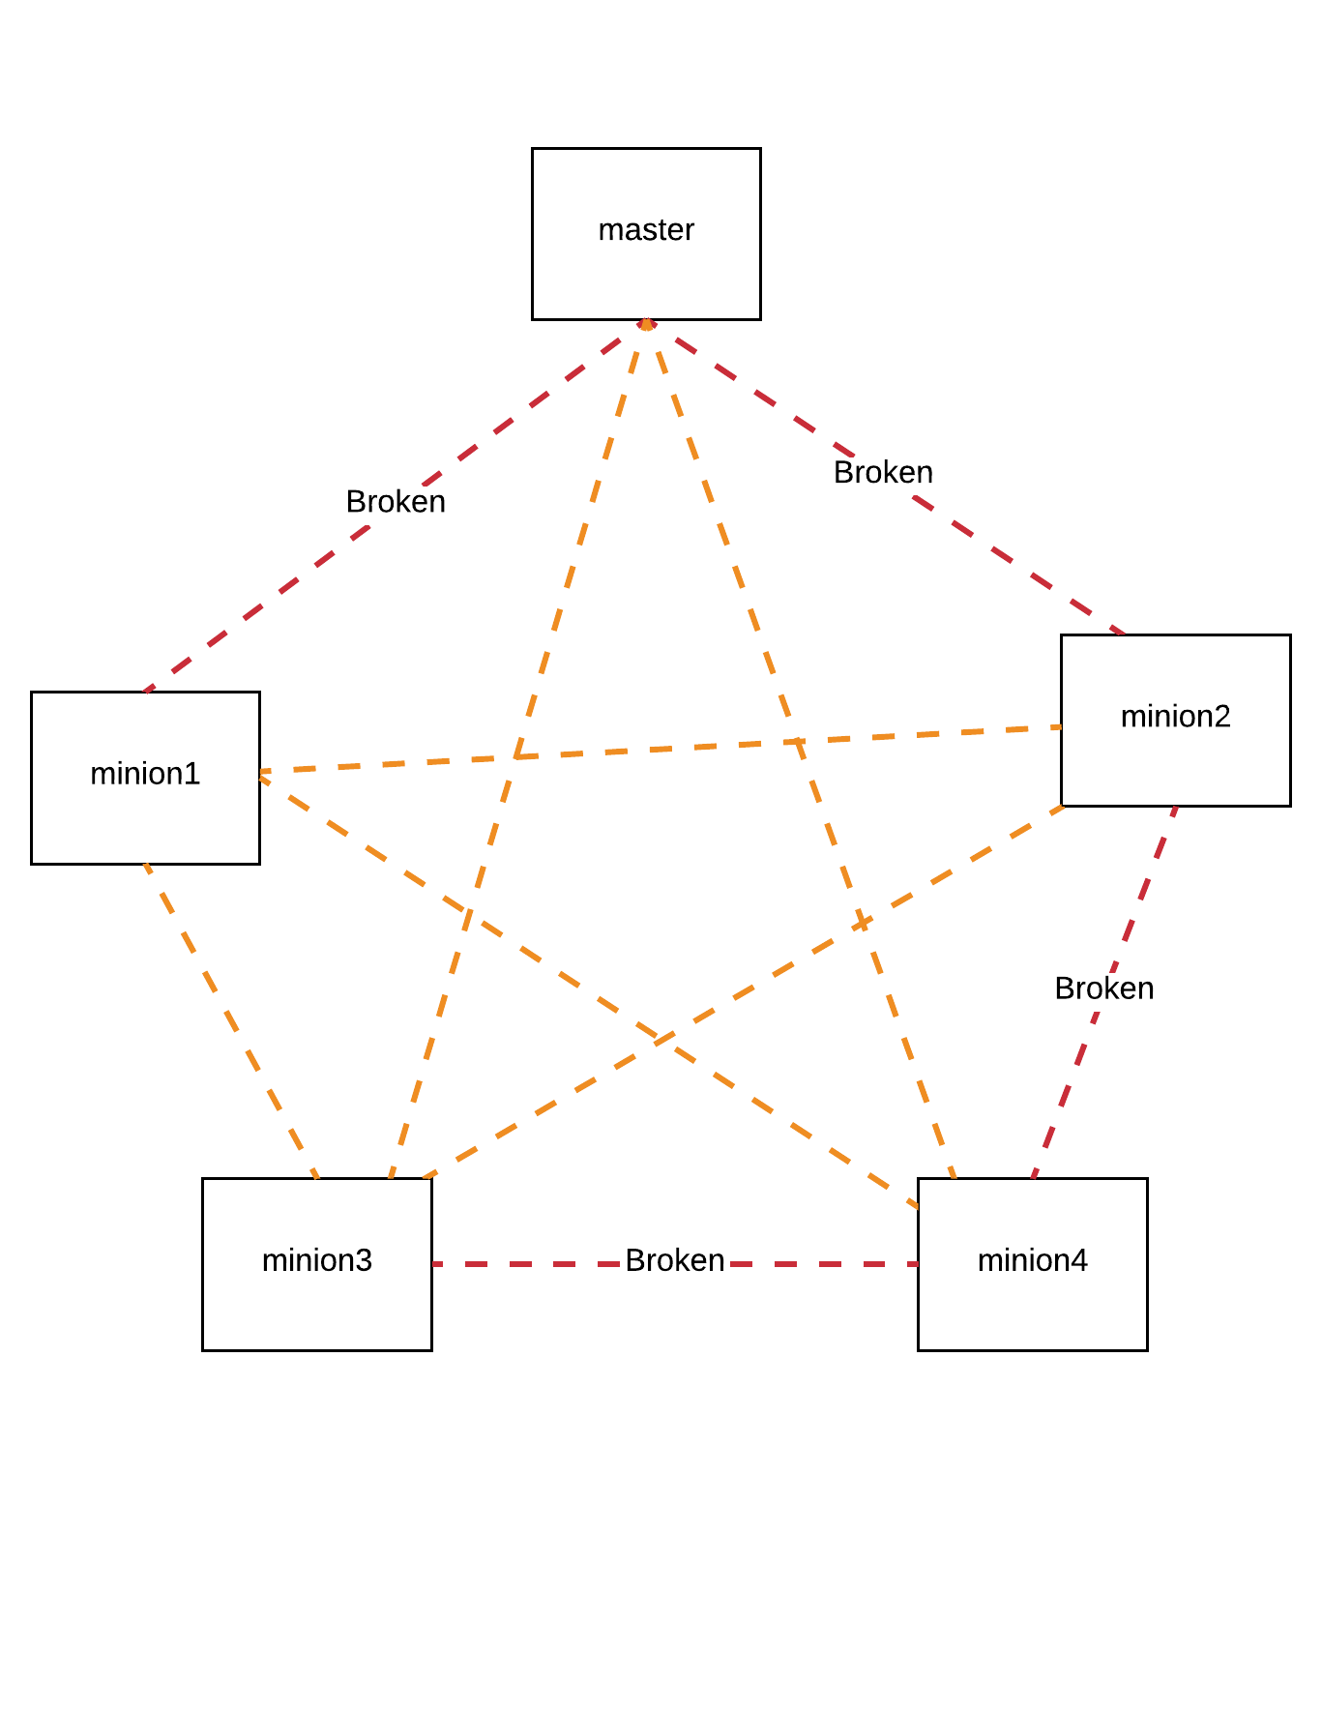

Slide 13
DEMO

Slide 14
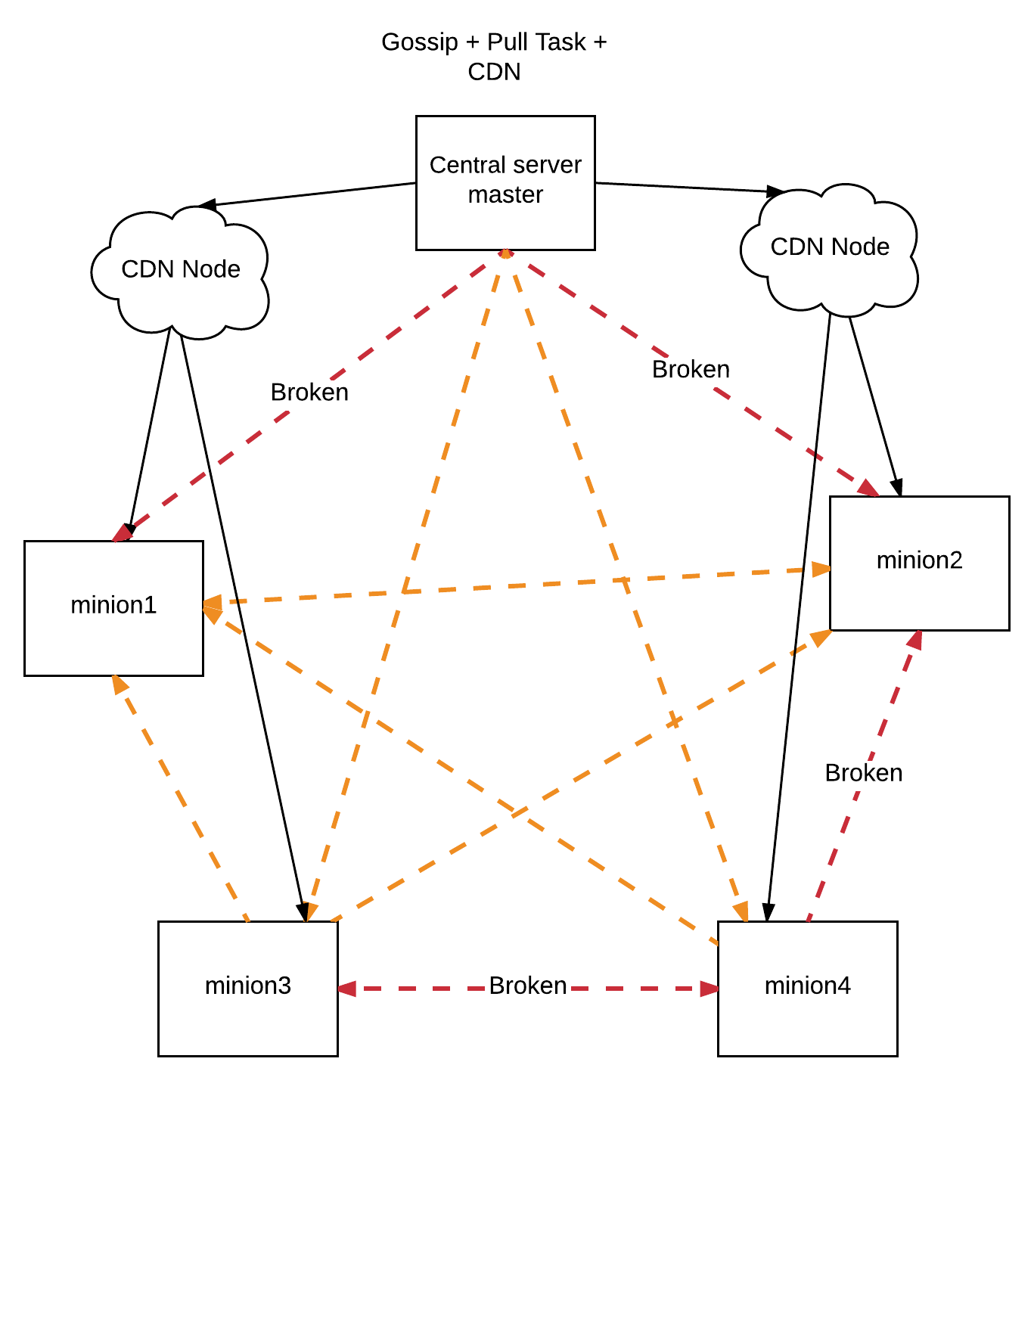
Gossip + Pull Task + CDN

Slide 15
Key Takeaways
Simple + Quick
Based on real-world phenomena, akin to social media “going viral”
Natural redundancy
Designed for scale
Doesn’t require a central sever, doesn’t matter if message is actually delivered
Any type of payload (within a certain size)
Probabilistic guarantees (propagation is independent of number of servers)
Simulation from http://brucespang.com/bimodal/simulation/

Slide 16

Risks/Cons
Requires application authentication/firewall
Need to open ports
Size of information/number of messages stored needs to be limited (requires bandwidth/memory)
Propagation at scale is not always 100% (is speed/reliability tradeoff worth it? Most of the time, YES!)

Slide 17
Some Practical Applications…
Chatroom
P2P Sharing/Streaming
Cache Purging
Device to device “chatroom” for sharing metadata
Do you have any ideas for use cases?

Slide 18
Additional Resources
Serf by Hashicorp: https://www.serf.io/
github.com/kiyor/scale15x
See you next year at SCALE 16x!
ChinaCache is hiring

